Slide 1
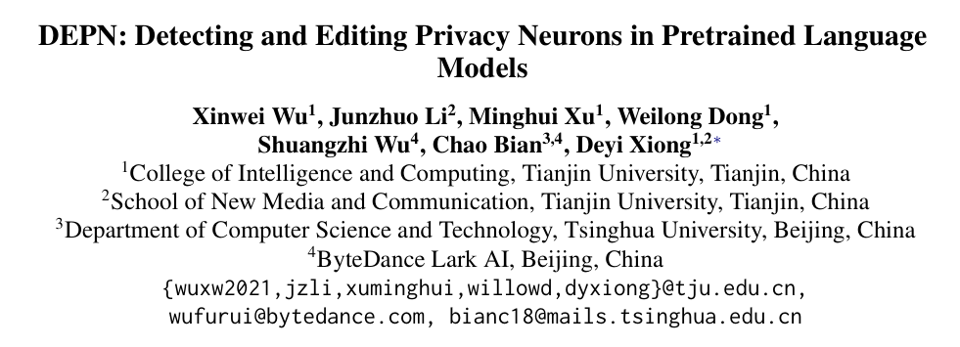
Inspired by model editing, the paper firstly proposed a neuron-based editing technique to the privacy issue of language models.
The method is efficient to reduce the privacy issue while maintaining the model performance successfully.

Slide 2
Background
Background
LLMs are pretrained on a huge amount of data;
A variety of methods have been explored to attack LLMs for training data extraction
Existing methods to protect privacy:
Data processing stage: removing sensitive information
training stage: reducing the extent to which models memorize training data
post-processing stage: retraining the model
Notes:
LLM: 需要在很大的数据集上进行预训练，这些数据上可能会包括一些隐私内容。而模型在训练中，会记住某些训练数据，这就带来了数据泄露和隐私泄露的风险。
目前当然也存在一些方法尝试提取一个模型的训练数据。
既然存在隐私泄露的风险，那么自然也会有许多工作来保护隐私。分为三个方面，数据预处理阶段，直接移除掉敏感的数据。

Slide 3
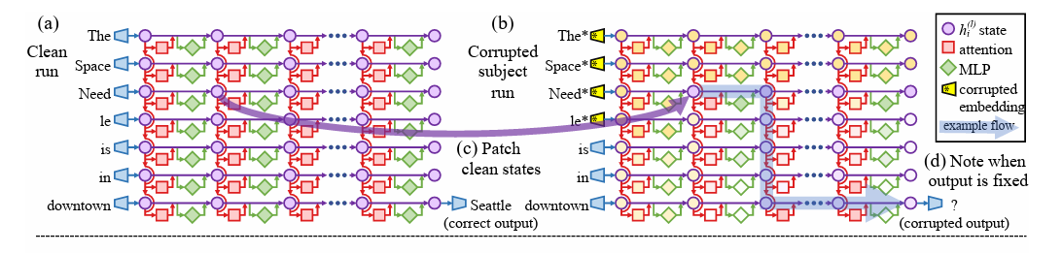
Background
Background
Factual knowledge is found to be stored in the feed-forward networks
Private information might be also encoded in specific neurons.

Slide 4
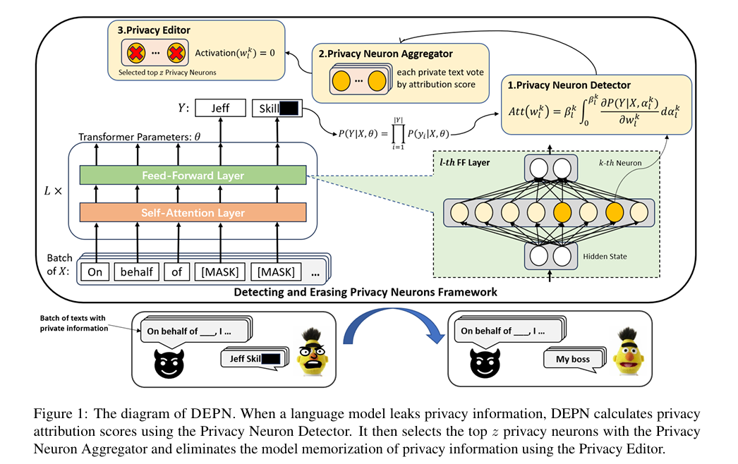
DEPN
DEPN
1. Neuron detector
2. Neuron aggregator
3. Privacy editor

Slide 5
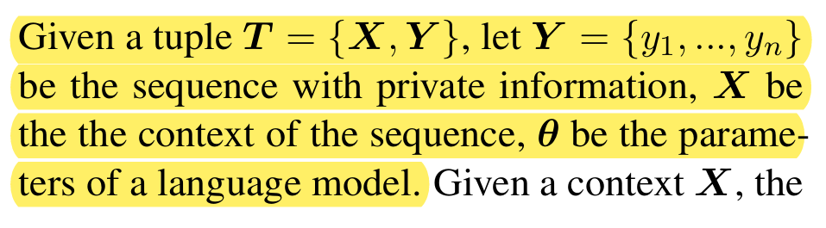
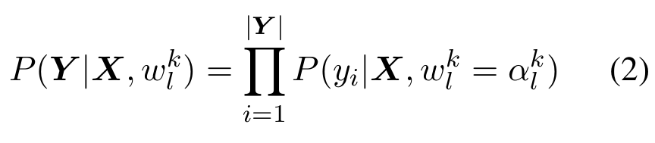
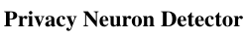
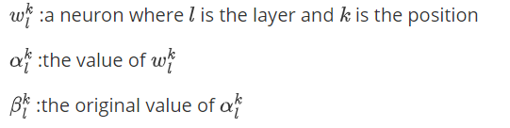
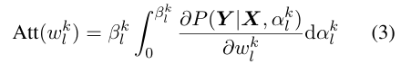
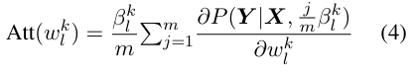
DEPN

Slide 6
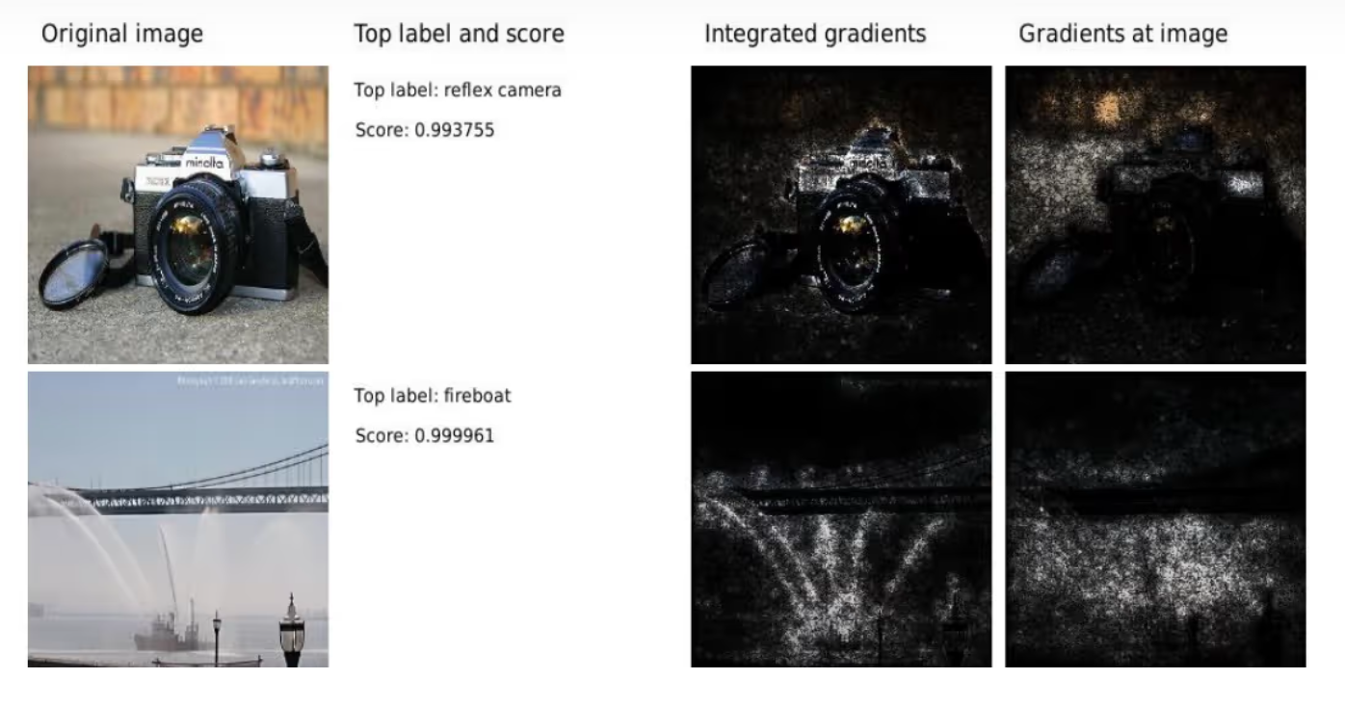
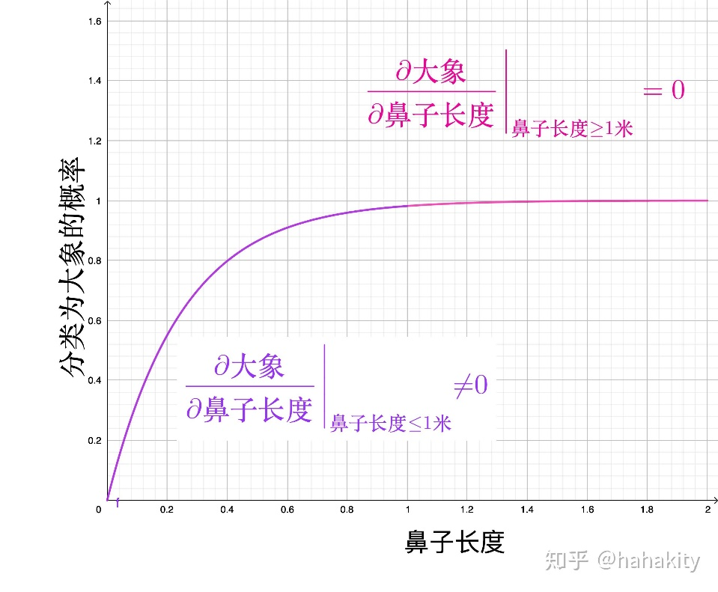
DEPN
When a pixel or feature is enhanced to a certain extent, its contribution to network decision-making may reach saturation.

Slide 7
Experiment
Privacy definition: personal identity in formation, such as names, ID numbers, phone numbers and other related expressions.
Dataset: Enron, containing over 500000 emails
Private information:
Names: 20 unique names that are memorized by language models
2) Phone numbers: 20 unique LM-memorized phone numbers
3) Private texts: 100 sentences that are not semantically overlapping with each other
__ __ is a senior writer at ESPN.com
My phone number is 71385 _ _ _ _ _.

Slide 8
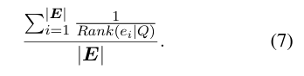
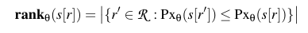
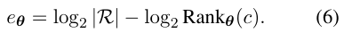
Experiment
BERT-F
BERT-FE
DEPN
BERT-O
DP-SGD
BERT-DP
Metrics:
1) Vaild-PPL: the Perplexity of Masked Language Modeling task on the Enron validation dataset. It is used to test LLM’s general performance.
3) Mean Reciprocal Rank(MRR): measure the model’s memorization of names.
4) Perplexity: measure the model’s memorization of sentences.
2) Exposure: measure the exposure risk of phone numbers
__ __ is a senior writer at ESPN.com
My phone number is 71385 _ _ _ _ _.
log-perplexity

Slide 9
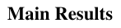
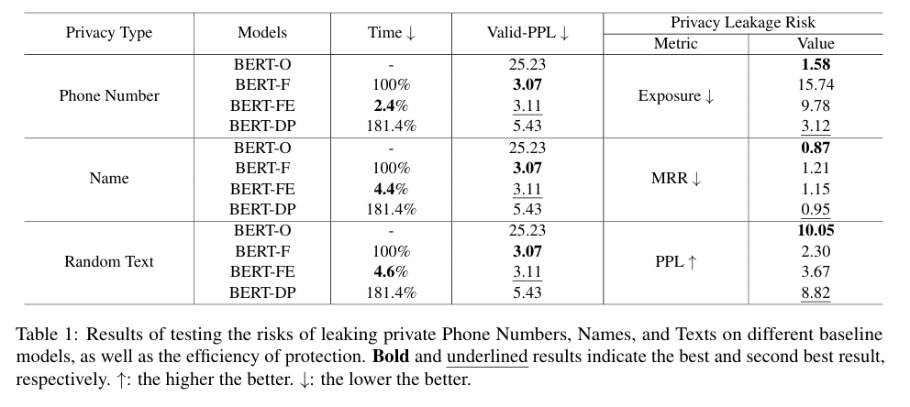
Experiment
DEPN’s performance was almost similar to BERT-F and has fewest execution time cost;
Regarding privacy leakage risk metrics, DEPN achieve the reduction of privacy leakage risk.

Slide 10
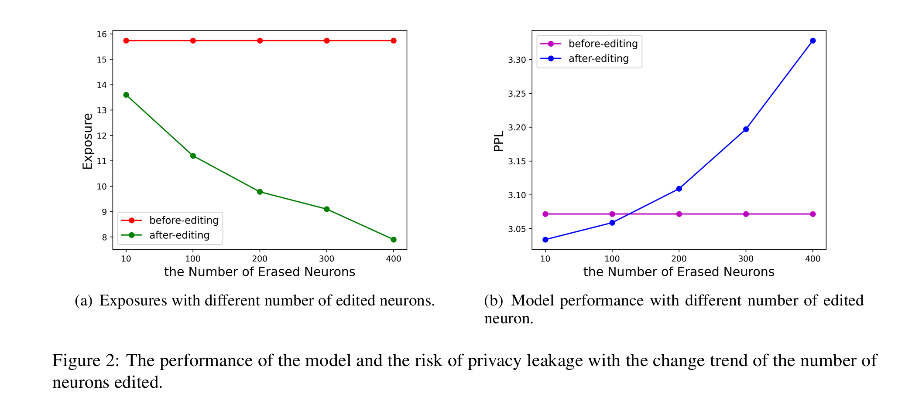
Experiment
Effect of the number of neurons edited
Increasing the number of edited neurons reduces the risk of privacy leakage in the model, but it also leads to a decrease in the model performance.

Slide 11
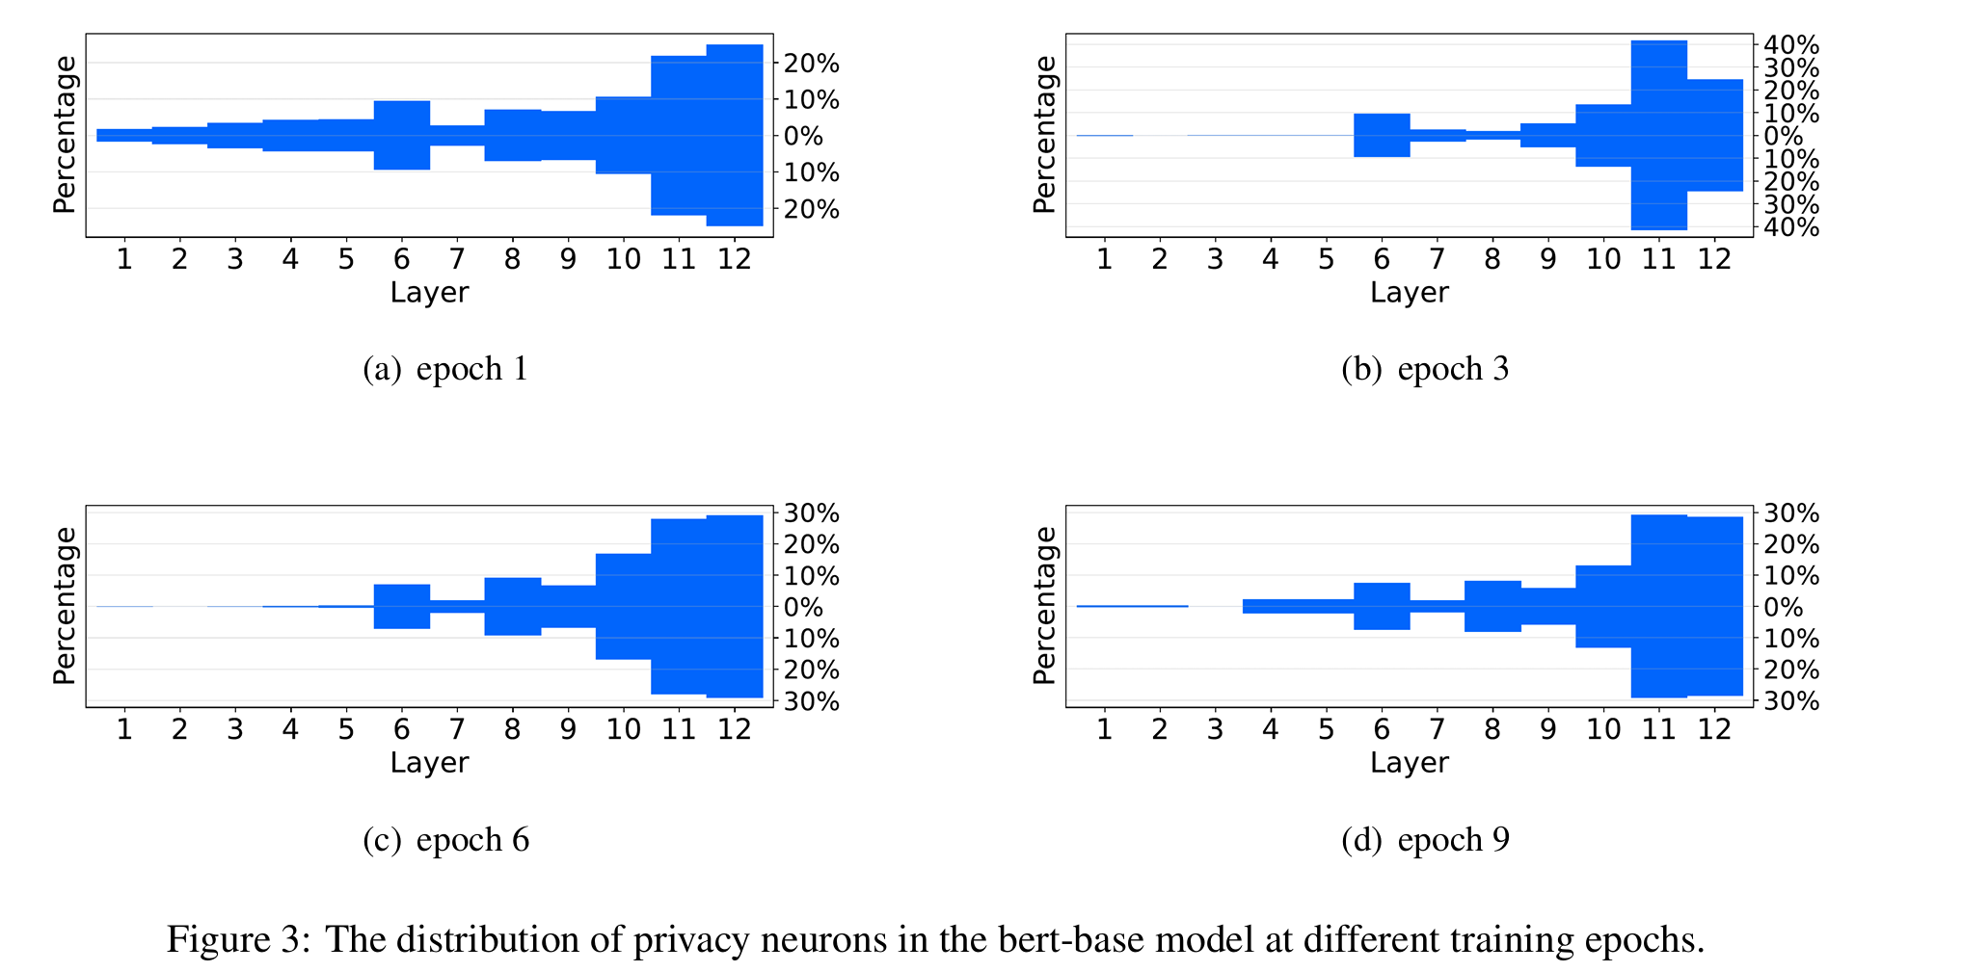
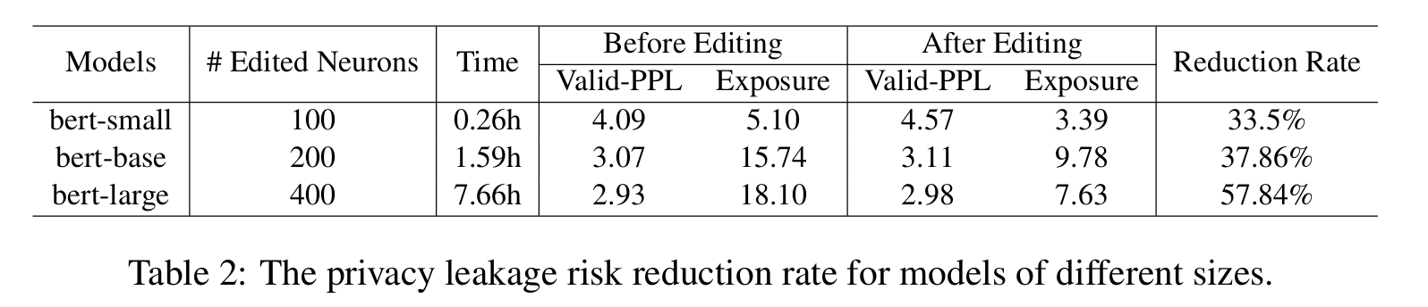
Experiment
Impact of Training Time on Privacy Neuron Distribution over Layers
As the training time increases, privacy neurons of top layers increases.
A model of a larger size has better performances on normal task. And DEPN demonstrates better performance on larger models.

Slide 12
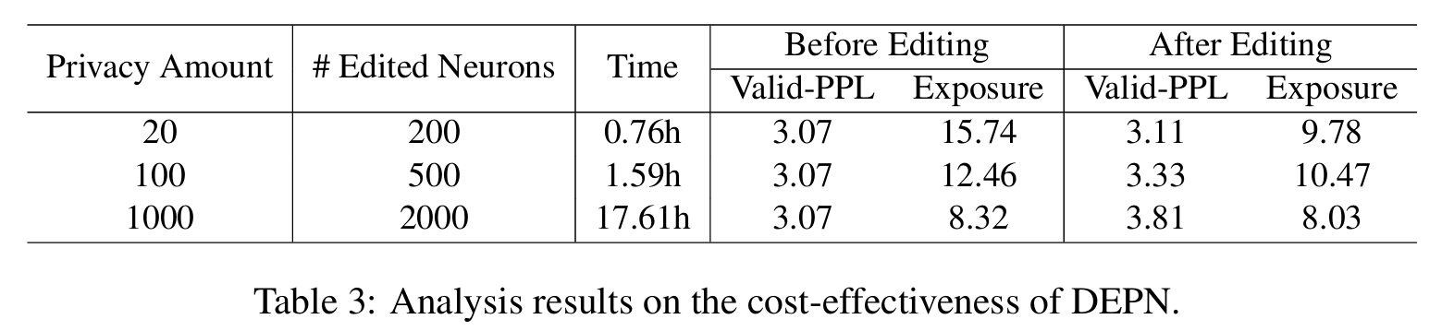
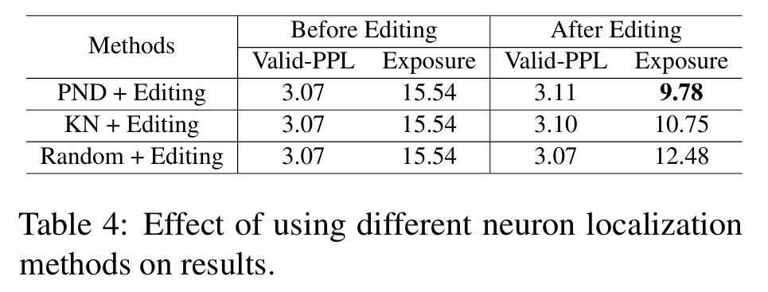
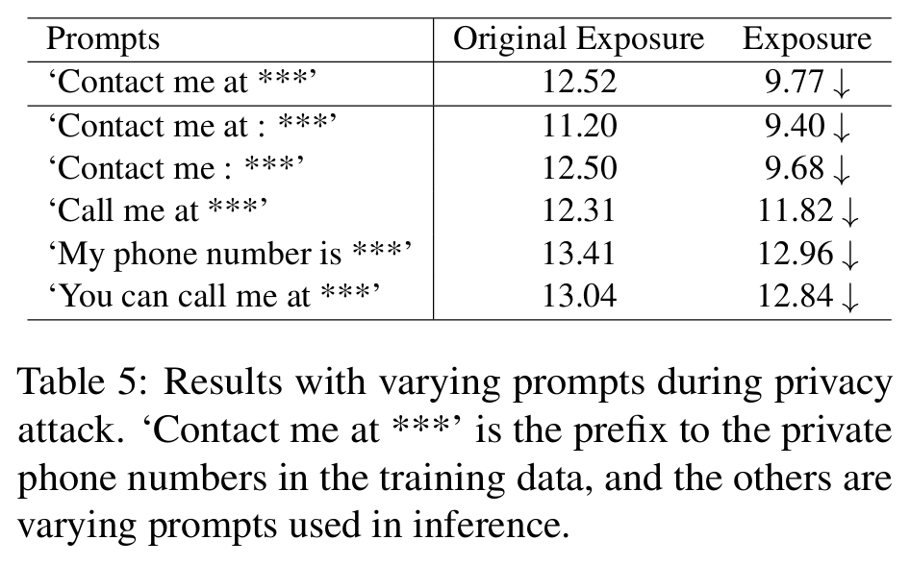
Experiment
Robustness analysis
There duction in privacy risks gradually diminishes as the amount of privacy increases.
Privacy risk reduction across all prompts

Slide 13
Thank you

